Slide 1
Brief Intro on Redis
Jingxuan Ai 2019/3/21

Slide 2
Index
Redis basic info
JavaScript Client / Java Client
More about Redis
More about Jedis (Java Client)
Current test result

Slide 3
Redis
Redis is written in ANSI C and works in most POSIX systems like Linux without external dependencies.
There is no official support for Windows builds, but Microsoft develops and maintains a Win-64 port of Redis.
Redis works with an in-memory dataset
Redis is good for frequently updated real-time data, such as session store, state database, statistics, and caching

Slide 4
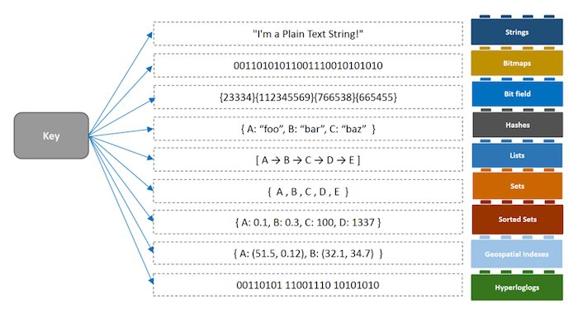
Redis Supported Data Structures

Slide 5
Redis Installation
For Unix-based systems: < https://redis.io/ >
For Windows: < https://github.com/MicrosoftArchive/redis/releases >
Java based free GUI for both Systems:
< https://github.com/caoxinyu/RedisClient >
NodeJS client: < https://github.com/NodeRedis/node_redis >
Java client: < https://github.com/xetorthio/jedis >

Slide 6
Redis Supported In most programming languages
JavaScript
Java
node_redis
  Support async commands
Jedis
  Light weight
  Not thread safe itself for most functions
Redisson
  Heavy weight with build-ing cluster support for distributed systems

Slide 7
JavaScript Example
A simple simulation of how Redis cache work

Slide 8
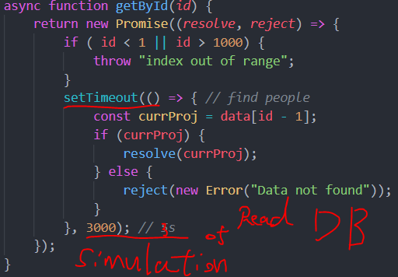
JS code for DB simulation

Slide 9
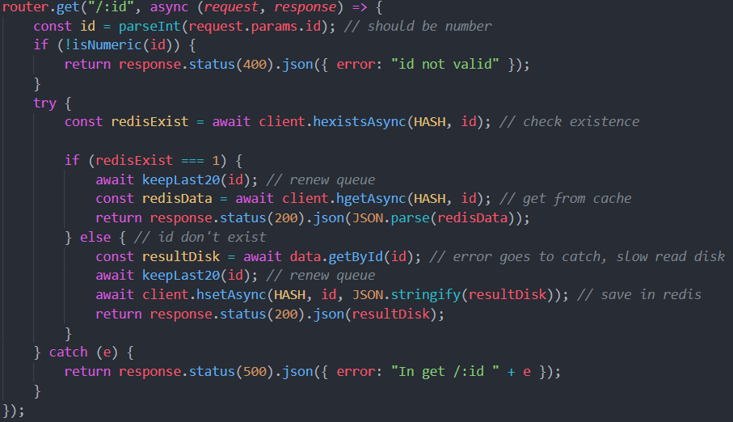
JS code for cache

Slide 10
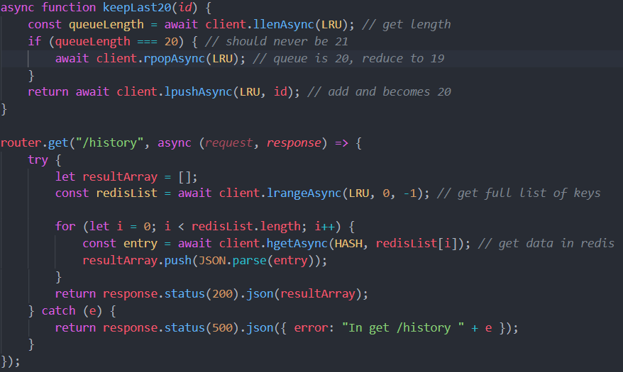
JS code for cache

Slide 11
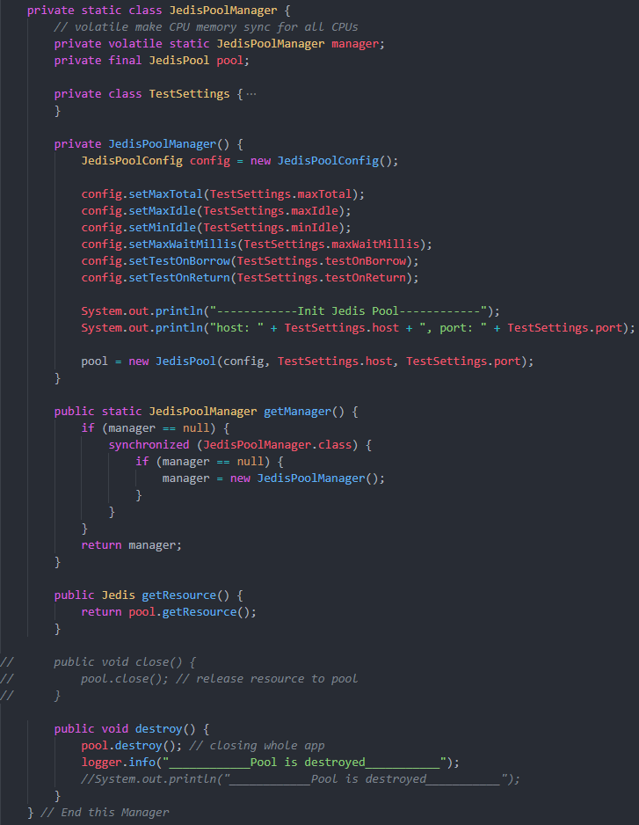
Jedis
Jedis has JedisPool for need of using Jedis under concurrent situations.
However each Jedis instance it self is not thread-safe and we tabke care of that.

Slide 12
More About Redis
Master / Slave < https://redis.io/topics/replication >
  it allows slave Redis instances to be exact copies of master instances.
Redis Sentinel < https://redis.io/topics/sentinel >
  Sentinel can create a Redis deployment that resists without human intervention to certain kind of failures.
  It’s suggested to use at least 3 server to run sentinel
Redis Cluster < https://redis.io/topics/cluster-tutorial >
  The ability to automatically split your dataset among multiple nodes.
  The ability to continue operations when a subset of the nodes are experiencing failures

Slide 13
Test Result
Write once => 0.453 s
Write 205k Trade (one day’s data) => Around 8s
Read once => < 0.000 s
Read 100k Trade => Redis command (0.391 s) => Full method 6.86 s
Read 380k Trade => Redis command (1.649 s) => Full method 28.28 s (100% CPU)
RAM used: roughly 2.3 G

Slide 14
Test About Read-Operation Memory Usage
Tested with 10 clients read one on today, 10 read one on lastday, 10 read all on today and 10 read all on lastday.
Heap Memory Usage:
Used: | 226,879 kbytes
Committed: | 348,160 kbytes
Max: | 2,752,512 kbytes
GC time: | 12.805 seconds on PS MarkSweep (35 collections)
 | 0.846 seconds on PS Scavenge (37 collections)

Slide 15
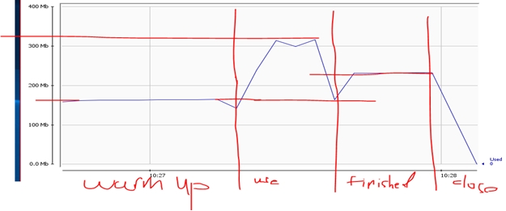

Slide 16
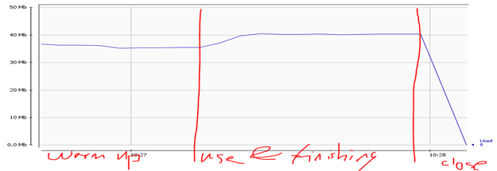
Non-Heap Memory Usage:
Used: | 226,879 kbytes
Committed: | 348,160 kbytes
Max: | 2,752,512 kbytes
GC time: | 12.805 seconds on PS MarkSweep (35 collections)
 | 0.846 seconds on PS Scavenge (37 collections)

Slide 17
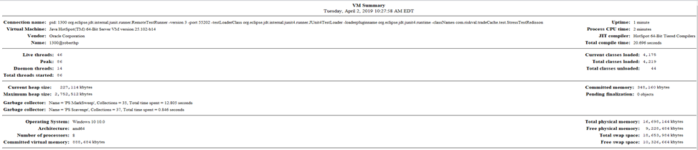
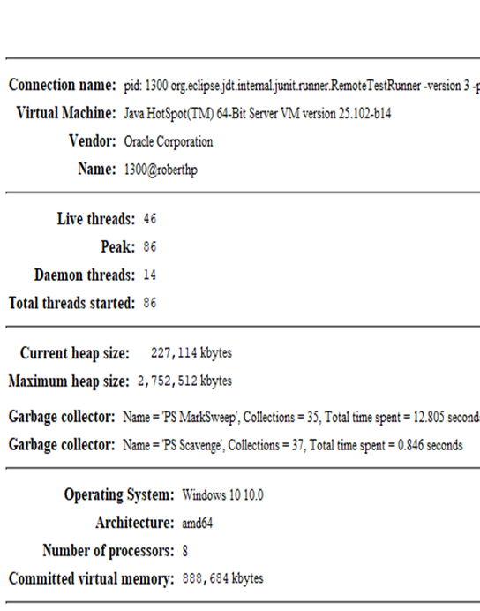
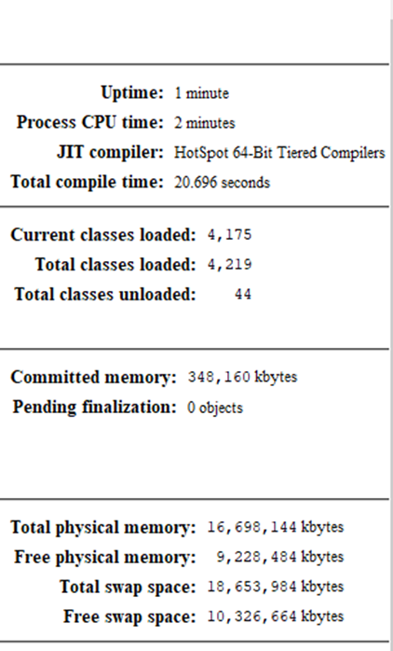
VM Summary

Slide 18
VM Summary
Committed memory is 340 mb, which fit what we observed in first figure. The Maximum heap size is for who JVM and it took 2.625 gb.

Slide 19
Thanks
Jingxuan Ai 2019/3/21

